Slide 1
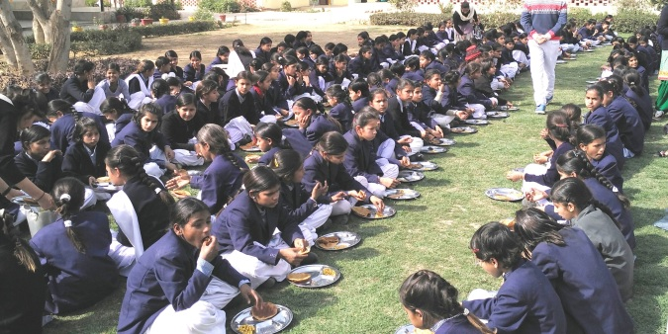
MID DAY MEAL SCHEME GOVT.OF HARYANA
ANNUAL WORK PLAN & BUDGET 2018-19

Slide 2
STRUCTURE OF PPT
Section I- Background
Section II- Count of Children & Institutions
Section III- Allocation & Utilization of funds
Section IV- Achievements
Section V- Review of assurance given in PAB 2017-18
Section VI- Monitoring Report
Section- VII- Joint Review Mission
Section- VIII-Proposal of funds for the year 2018-19

Slide 3
BRIEF NOTE - MID DAY MEAL SCHEME
Dry ration was distributed to the children before 2004.
Serving of cooked food was started in all Government schools, Local bodies, Government aided primary schools from 15.08.2004 onwards.
The scheme was further extended to all middle schools during the academic year 2008-09.
Objectives:
To attract Out-of-School Children (OoSC).
To retain the in-school children.
To improve the health of students.
Norms:
To provide 450 calories of energy/100 gms. of food grains to primary students.
To provide 700 calories of energy/150 gms. of food grains to upper primary students.
To provide 20 gms/ 30 gms proteins respectively to primary and upper primary students.
Cooking Cost :
Components of cooking cost include pulses, vegetables, cooking oil and fuel.
Rs. 4.13 for every primary student and Rs. 6.18 for every upper primary student has been provisioned toward cooking cost.

Slide 4
MANAGEMENT STRUCTURE
Additional Chief Secretary School Education
Director Elementary Education
Additional Director Mid Day Meal
District Elementary Education Officer
Block Elementary Education Officer
School

Slide 5
SECTION –II
COUNT OF CHILDREN
&
INSTITUTIONS

Slide 6
Count of Institutes and Children covered in 2017-18
Types of Schools | Institutes | Enrolment in 2017-18 | Beneficiaries in 2017-18
Primary | 8651 | 962549 | 927837 (96.39%)
Upper Primary | 6304 | 636205 | 621827(97.74%)
NCLP (special Training Centers) | 35 | 2328 | 1675(71.95%)
Total | 14990 | 1601082 | 1551339(96.89%)
NCLP (National child labour Project) (Special Training Centres) are Govt. of India Schools under labour Department in two districts Faridabad & Gurgaon .

Slide 7
Total No. of Institutions & Enrolment during the Year 2017-18 & 2018-19
Types of Institutions | No of Institutions & Enrolment 2017-18 |  | No of Institutions & Enrolment 2018-19
 | No of institutions | Enrolment | No of institutions | Enrolment
Govt. Primary Schools | 8651 | 962549 | 8822 | 952828
Upper Primary | 6304 | 636205 | 5881 | 657455
NCLP Centres | 35 | 2328 | 35 | 2553
Grand Total | 14990 | 1601082 | 14738 | 1612836

Slide 8
SECTION –III
ALLOCATION & UTILIZATION OF FUNDS/FOODGRAINS

Slide 9
Quantity Of Food Grains-Allocated, Lifted & Utilization for Schools
(Qty in Metric Tonnes)
Foodgrains | Allocation Upto 31-3-2018 | Opening Balance as on 1-4-17 | Lifting (Upto 31-3-2018) | Utilization (Up to 31-3-2018)
Primary | 20355.47 | 184.04 | 14945.16 | 15055.54
Upper Primary | 21051.93 | 153.73 | 14867.99 | 14698.63
Total | 41407.4 | 337.77 | 29813.15 | 29754.17

Slide 10
Total Budgetary allocation for the year 2017-18
(Rs. in Cr)
Period | Approved Centre Share | Approved State Share | Total | Expenditure Up to 31-12-2017
Allocation upto 31-3-2018 | 138.69 | 166.46 | 305.15 | 251.05 (82.27%)
Released Upto 31-03-2018 | 99.54 | 151.51 | 251.05

Slide 11
Budget Allocation & Expenditure on cooking cost upto 31-03-2018
Rs. In Crore.
Class Category | Approved Budget |  |  | Unspent Balance of last year (CS+SS) | Released Amount (CS+SS) | Total (CS+SS) | Expenditure
 | Centre Share | State Share | Total
Primary | 50.48 | 33.59 | 84.07 | 22.56 | 62.87 | 85.43 | 76.64 (89.39%)
U.Pry | 52.04 | 34.69 | 86.73 | 22.58 | 58.89 | 81.47 | 72.23 (89.09%)
Total | 102.52 | 68.28 | 170.80 | 45.14 | 121.76 | 166.90 | 148.87 (89.25%)
*.

Slide 12
Budget Allocation & Expenditure on Cost of Foodgrains upto 31-03-2018
(Rs. In Cr.)
Class Category | Approved Budget (100% Centrally sponsored) | Unspent Balance of last year (CS) | Released Amount (CS) | Total (CS) | Expenditure
Primary | 5.74 | 3.65 | 2.62 | 5.72 | 4.32(75.52%)
U.Pry | 5.93 | 3.09 | 2.34 | 5.98 | 3.83(64.04%)
NCLP | 0.07 | 0.00 | 0.02 | 0.02 | 0.02 (100%)
Total | 11.74 | 6.74 | 4.98 | 11.72 | 8.17(69.70%)
* FCI bill is pending for 2 districts ( Palwal and Gurugram) . They have received bill in the month of May 2018.

Slide 13
Budget allocation & Expenditure towards Honorarium for Cook cum Helper
(Rs. In Cr.)
Stage | No. of Cooks Approved by GOI | No. of Cooks actually Working | Approved budget by GOI | Unspent Balance of last year (CS+SS) | Released Amount (CS+SS) | Total (CS+SS) | Expenditure up to 31-12-16
Pry. | 18652 | 18556 | 46.63 | 0 | 46.63 | 46.63 | 44.25 (94.89%)
U.Pry | 11771 | 11637 | 29.42 | 0 | 29.42 | 29.42 | 28.63 (97.32%)
Total | 30423 | 30193 | 76.05 | 0 | 76.05 | 76.05 | 72.88 (95.83%)

Slide 14
Budget Allocation & Expenditure on Management Monitoring & Evaluation(MME) upto 31-03-2018
(Rs. In Cr.)
Class Category | Approved Budget (100% Centrally sponsored) | Unspent Balance of last year (CS) | Released Amount (CS) | Total (CS) | Expenditure
Primary | 1.33 | 1.06 | 0.27 | 1.33 | 0.79 (56.39%)
U.Primary | 1.12 | 0.79 | 0.32 | 1.11 | 0.50 (45.05%)
Total | 2.45 | 1.85 | 0.59 | 2.44 | 1.29 (52.87%)

Slide 15
Budget Allocation & Expenditure on Transportation Cost upto 31-03-2018
(Rs.In Cr.)
Class Category | Approved Budget (100% Centrally sponsored) | Unspent Balance of last year (CS) | Released Amount (CS) | Total (CS) | Expenditure
Primary | 1.94 | 0.24 | 1.70 | 1.94 | 1.12 (57.73%)
U.Primary | 1.16 | 0.21 | 0.94 | 1.15 | 1.03 (89.57%)
Total | 3.10 | 0.45 | 2.64 | 3.09 | 2.15 (69.58%)
* Hafed has not submitted 4th quarter bill till now.

Slide 16
Recipes
The schools Children are provided cooked food as per menu decided by the Department. As per the observations of Joint Review Mission more vegetables and pulses have been included so that children could receive prescribed nutritive value through meal, therefore recipes have been reviewed and now thirteen recipes (7 wheat based & 6 rice based) are being served with w.e.f. 01-04-2014. In 2016 three more recipes have been added in menu to include milk. New recipes are as under:-
Wheat based | Rice Based
Missi Roti with seasonal vegetable | Vegetable Pulao
Halwa with black channa | Postik Khichdi
Roti with Daal ghiya/kaddu | Rajma and Rice
Meetha Daliya | Karhi Pakora and Rice
Wheat soya puri and vegetable. | Sweet Rice
Paushtik Dalia | Kheer
Meetha Pura

Slide 17
SECTION –IV
ACHIEVEMENTS

Slide 18
Mid Day Meal Week
Mid Day Meal week was organized in 21 districts of the State from 5 to 12th September. During this week following activities were covered:
05.09.2017 : In all schools hand washing day has been celebrated.
06.09.2017: All schools have celebrated Beti ka Janamdin-School mai Abhinandan.
07.09.2017 & 08.09.2017 : Health check-up of children with the help of health department and also provided health supplements to children.
11.09.2017 : Medical check up of all cooks with the help of health Department.
11.12.2017: Training provided to all cooks for cleanliness , quality of food by Master Trainers at Block Level.

Slide 19
Milk Started

Slide 20
Sr.No | Name Of District | Name Of Block | Name Of School
1 | Kurukshetra | Pehowa | GPS Rua
2 | Kurukshetra | Pehowa | GHS Rua
3 | Kurukshetra | Thanesar | GPS Doda Kheri
4 | Kurukshetra | Thanesar | GPS Dera Brahamanpuri
Since 2011 the Mid Day Meal has not been given in the above 4 schools but now from 15/12/2017 the mid day meal has been started/given in the above schools.

Slide 22
Hand wash before and after Mid Day Meal

Slide 23
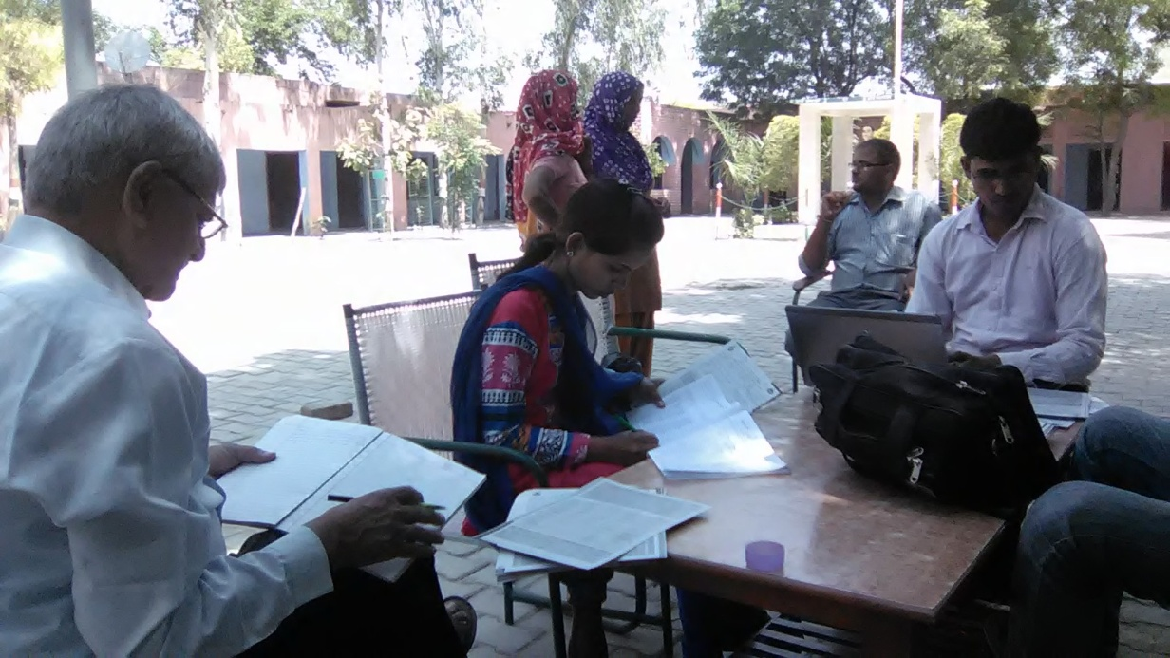
Health Check-up of Cooks.

Slide 24
School Health Programme
No of schools covered | 14990
No of childrens covered | 1601082
Iron and Folic acid supplement | 1394448
Deworming tablet | 2788896
Distribution of spectacle | 542
In addition to this during Mid Day Meal week health check up of children done with the help of NHM.

Slide 25
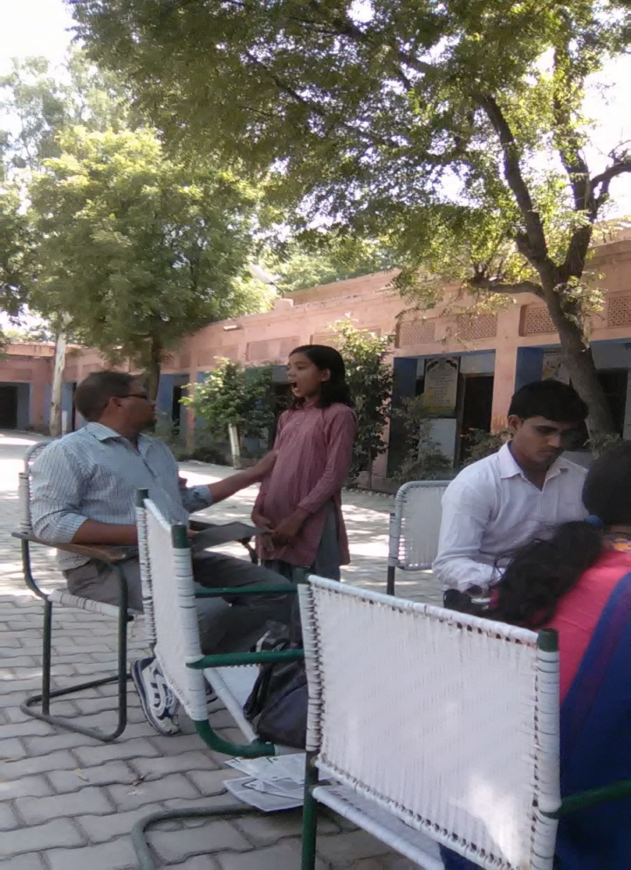
Health Check-up of children.

Slide 26
Best Practices
Tithi Bhojan:-
Every 3rd Tuesday of the month is celebrated as girl student’s birthday jointly as “Beti ka Janamdin”- School Mai Abhinandan . All the girls whose birthdays fall in the given month are congratulated and given a special treatment.
It also aimed that encouraging the community participation as parents are also invited to those celebrations and are given a window of free participation in Mid Day Meal and other activities of the schools.
In Haryana State Honorarium to cooks is Rs. 2500/-per month in which Centre Share is Rs.600/- and State Share is Rs.1900/- per month against the mandatory State share of Rs. 400/- per month from 1st January 2014.
Medical examination of CCHs done twice a year.
Kitchen gardens are available in 10 schools of Ambala District .
Provision of steel thalis and spoons for children for eating MDM.
Construction of toilets for physically challenged children in Mewat district.
Availability of good quality aluminium storage bins for storing food grains

Slide 27
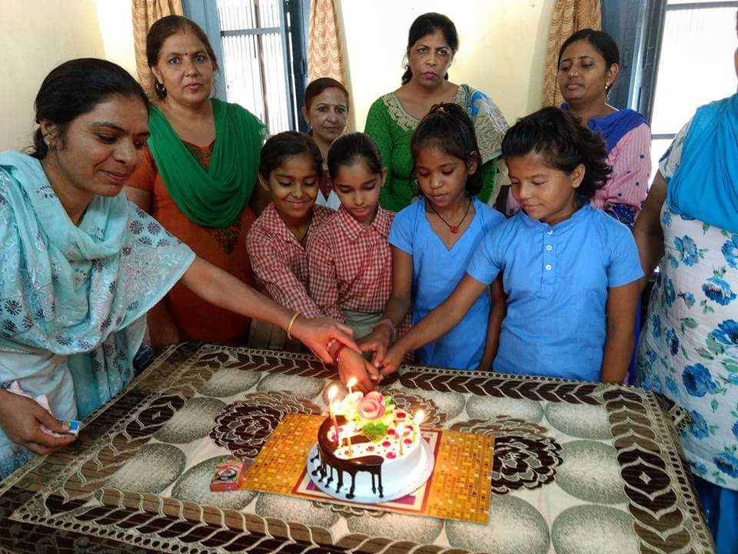
Celebration of “Beti ka Janamdin- School mai Abhinanadan”

Slide 28
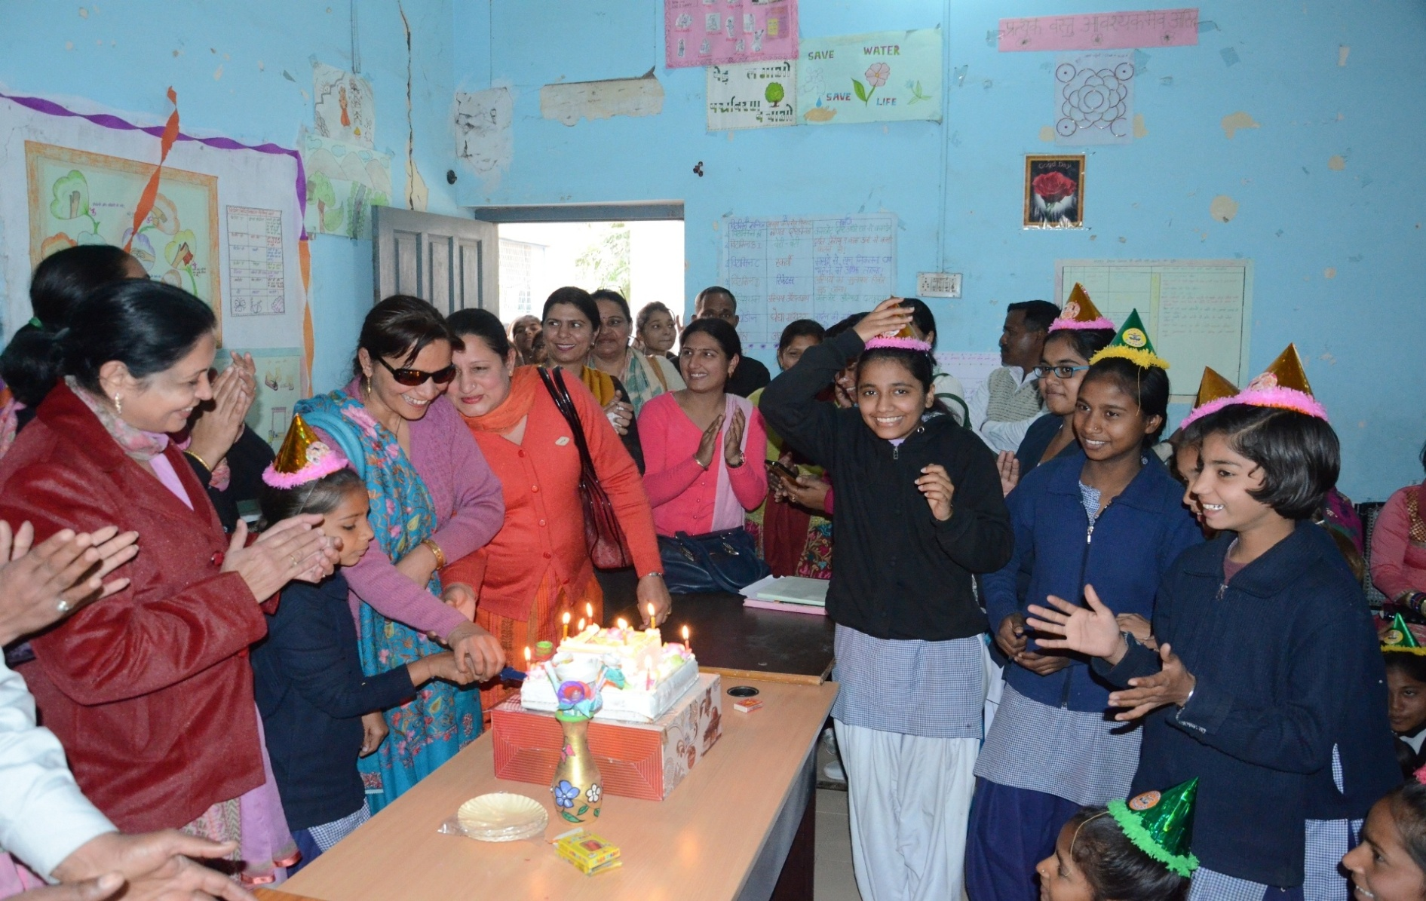
Celebration of “Beti ka Janamdin- School mai Abhinanadan”

Slide 29
SECTION – V
REVIEW OF ASSURANCE GIVEN IN PAB 2017-18

Slide 30
ACTION TAKEN ON PAB ASSURANCE
Sr.No. | PAB Advice | Office Remarks
1 | To enhance the coverage of enrolled Children | All the District Elementary Education Officers have been directed to instruct all schools to provide MDM to all enrolled students.
2 | To ensure e-transfer of funds to all the remaining cook cum helpers and payment of honorarium to cooks into their bank accounts | In this regard it is stated that all the cooks are being paid their honorarium through e-transfer/account payee cheques.
3 | To complete the remaining 987 kitchen cum store as on 31.05.2018 | Director SSA has been requested to complete the remaining kitchen cum store up-to 31.05.2018. Constructed 9250 In progress 1246 Not started 987
*2 SHG have many members and they work in rotation and paid by account payee cheque.

Slide 31
Continued…
Sr.No. | PAB Advice | Office Remarks
4 | To do the health checkup of all the enrolled children twice a year | NRHM has already been requested to do the health checkup of all the enrolled children at least twice a year. and addition to this it has been decided to celebrate mid Day Meal Week from 5-12 September 2017. During this week medical checkup of all students & cooks has been done by NHM.
5 | To look into the issue of delay in release of fund from State to District Level | In the meeting of SSMC held on 4.06.2018 committee advised Elementary Education Deptt. and Finance Deptt. to release the funds expeditiously for smooth functioning of MDMS.

Slide 32
SECTION – VIII
PROPOSAL OF FUNDS FOR THE YEAR 2018-19

Slide 33
Children proposed to be covered in 2018-19
Type of School | No. of children
Primary | 952828
Upper Primary | 657455
NCLP | 2553
Total | 1612836

Slide 34
Total requirement of Budget for 2018-19
(Rs. in Cr.)
Center’s Share | State’s Share | Total
155.08 | 233.51 | 388.59

Slide 35
Component wise requirement of Budget for the Year 2018-19
(Rs.In Cr.)
Component | Centre Share | State Share | Total requirement for 2017-18
Cost of Food grains | 10.51 | 0.00 | 10.51
Transportation Cost | 3.39 | 0.00 | 3.39
Cooking Cost | 116.54 | 77.56 | 194.10
Honorarium Cook cum Helper @ Rs.2500/- per month | 21.91 | 69.39 | 91.30
MME | 2.74 | 0.00 | 2.74
Milk Provision | 0.00 | 86.56 | 86.56
Total | 155.08 | 233.51 | 388.59

Slide 36
Requirement of Budget for the Year 2018-19(Primary Stage)
(Rs. In Cr.)
Component | Centre Share | State Share | Total requirement for 2017-18
Cost of Food grains | 5.92 | 0.00 | 5.92
Transportation Cost | 1.66 | 0.00 | 1.66
Cooking Cost | 57.28 | 38.11 | 95.39
Honorarium Cook cum Helper @ Rs. 2500 per month i.e. Rs.600/-CS &Rs.1900/- SS | 13.46 | 42.63 | 56.09
MME | 1.41 | 0.00 | 1.41
Milk Provision | 0.00 | 52.62 | 52.62
Total | 79.73 | 133.36 | 213.09

Slide 37
Requirement of Budget for the Year 2018-19 (Upper Primary Stage)
(Rs. in Cr.)
Component | Centre Share | State Share | Total requirement for 2017-18
Cost of Food grains | 4.59 | 0.00 | 4.58
Transportation Cost | 1.73 | 0.00 | 1.73
Cooking Cost | 59.26 | 39.45 | 98.71
Honorarium Cook cum Helper @ Rs. 2500 per month i.e. Rs.600/-CS &Rs.1900/- SS | 8.45 | 26.76 | 35.21
MME | 1.33 | 0.00 | 1.33
Milk Provision | 0.00 | 33.94 | 33.94
Total | 75.36 | 100.15 | 175.50

Slide 38
Requirement of Budget for the Year 2018-19 for (National Child Labour Project Schools(NCLP)
(Rs. in Cr.)
Component | Centre Share | State Share | Total requirement for 2018-19
Cost of Food grains | 0.0312 | 0.00 | 0.0312
Transportation Cost | 0.0087 | 0.00 | 0.0087
Cooking Cost | 0.2292 | 0.1526 | 0.3818
MME | 0.0048 | 0.00 | 0.0048
Milk Provision | 0.00 | 0.1853 | 0.1853
Total | 0.2739 | 0.3379 | 0.6118

Slide 39
Proposal for MME 2018-19
Sr.No | Particulars | Amount required (Rs. In Cr.)
1 | School Level Expenses | 1.00
(i) | Form & Stationery
(ii) | Training of cook cum helpers
(iii) | Replacement/repair/maintenance of cooking device, utensils, etc.
(iv) | soaps for washing hands
 | Sub Total | 1.00
2. | Management, Supervision, Training, Internal Monitoring and External Monitoring
(i) | Hiring charges of manpower at various levels | 1.40
(ii) | Transport & Conveyance | 0.10
(iii) | Office expenditure | 0.01
(iv) | Furniture, hardware and consumables etc. | 0.01
(v) | Capacity builidng of officials | 0.01
(vi) | Publicity, Preparation of relevant manuals | 0.01
(vii) | External Monitoring & Evaluation | 0.20
 | Sub Total | 1.74

Slide 40
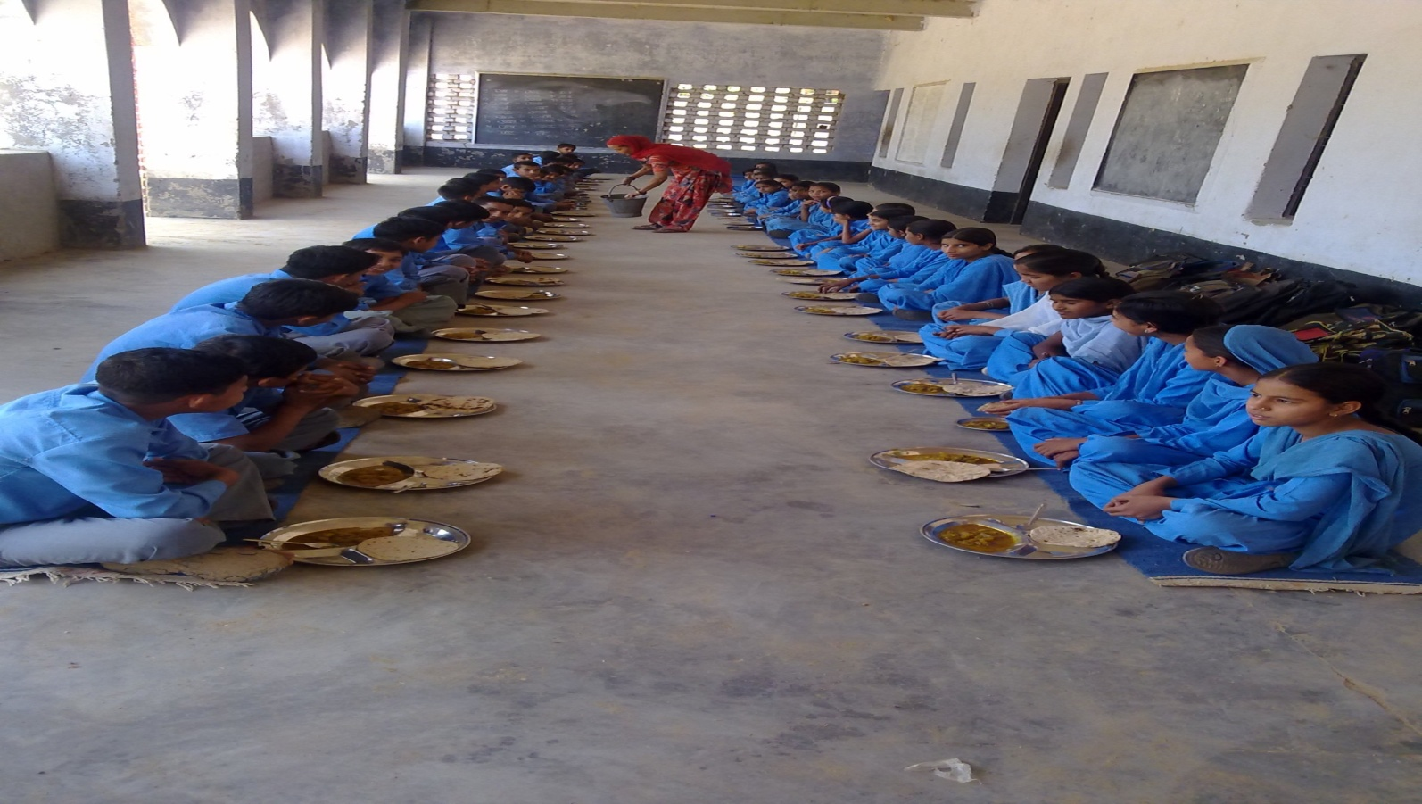
Thank You

